Slide 1
WONDER WINGS By: Binary Brains

Slide 2
Agenda
Enhancing Inclusive Education for Specially-Abled Children in India with mental disorders.
Target audience: Children of Age Group between 3-10.
Elementary School Education.
Transparent Infrastructure.
Scalability: Collab with NGOs.

Slide 3

Solution:
Developing a centralized web platform providing essential information on disability provisions, best practices, and resources for accessible learning environments.

Slide 4
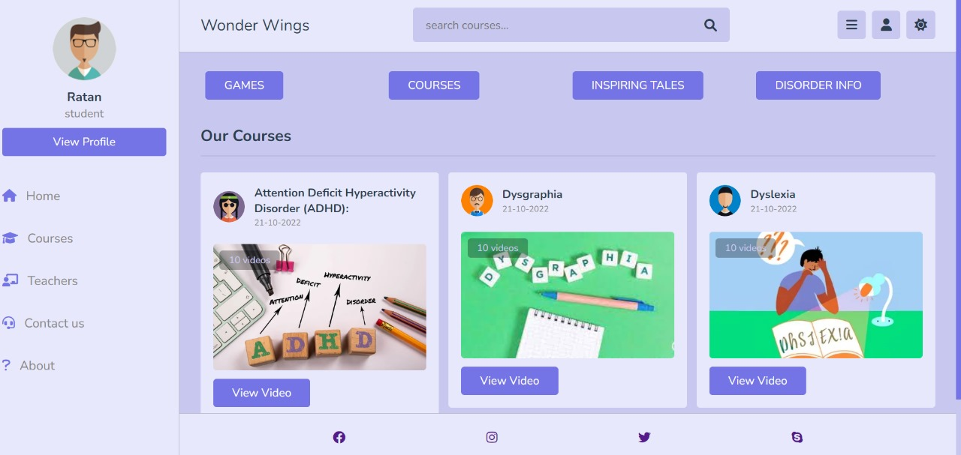
PROTOTYPE:

Slide 5
FRAMEWORK:
Registration.
Profile Making.
Disorder Diagnosis.
Fun Games and Activities.
Evaluation of Student.
Generation of Score Card and Report.
Recommendation of Modules and Courses based on Score Card.
Sending Report to NGOs and Providing Personal
Support.

Slide 6
CONCLUSION:
This web platform utilizes technology to spread knowledge aiming to drive positive change and create a more inclusive educational environment for specially-abled children in India.

Slide 7
Thank you
Team No. 5:
Gagankumar Seth
Maharshi Singh
Om Jain
Samarpit Jain

